Slide 1

Dynamic Logistic Ensembles with Recursive Probability and Automatic Subset Splitting for Enhanced Binary Classification
Mohammad Zubair Khan
David Li
Katz School of Science and Health, Yeshiva University, NY, USA

Slide 2
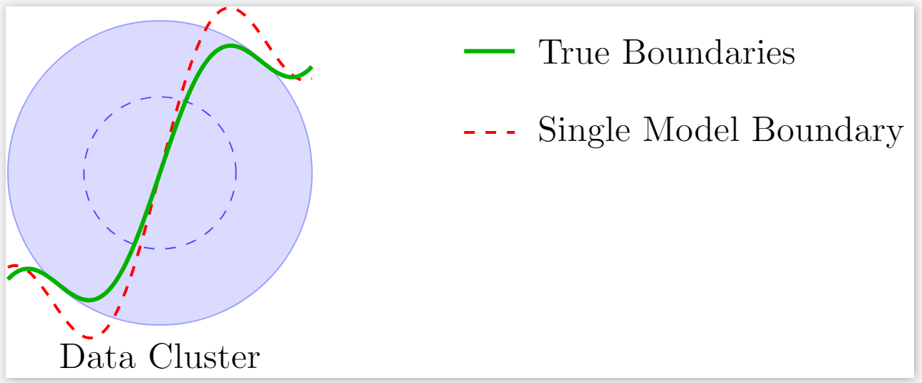
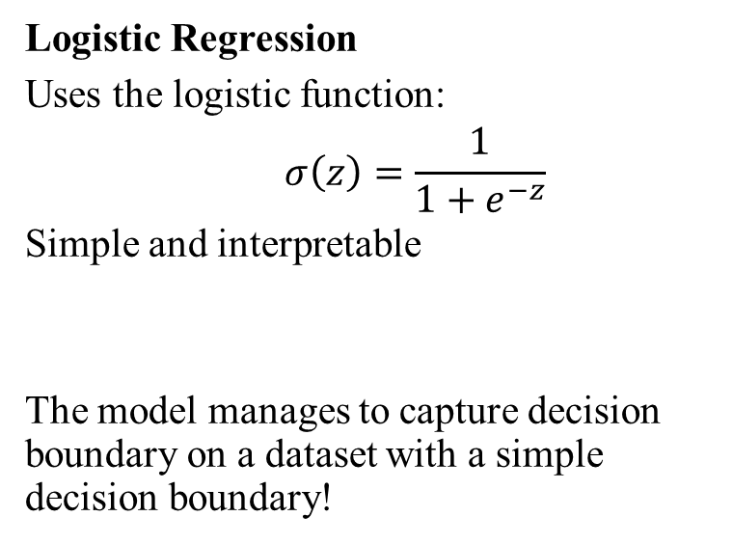
Simple logistic regression model
Logistic Regression
Uses the logistic function:
$$σ\left(z\right)=\frac{1}{1+e^{−z}}$$
Simple and interpretable
The model manages to capture decision boundary on a dataset with a simple decision boundary!
Single Logistic model on a simple dataset

Slide 3
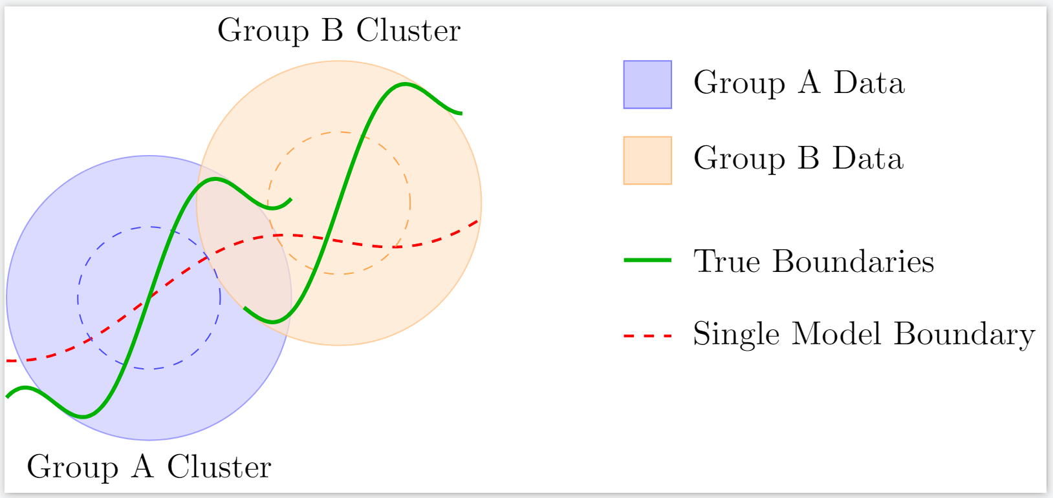
What if the decision boundary is not simple?
This is the case with most of the real world scenarios!
Simple logistic regression suffers in situations where internal groupings are present
Then for better performance we move to the models where we loose interpretability
A little complex dataset

Slide 4
Existing ensemble models that address this issue
Ensemble Methods
Bagging: Reduces variance by averaging multiple models
Boosting: Reduces bias by focusing on misclassified instances
Limitations
Often rely on complex base learners (e.g., decision trees)
Compromise interpretability
In the real world interpretability is really important.
Ensemble Method | Interpretability | Complexity
Single Logistic Regression | High | Low
Bagging (Bootstrap Aggregating) | Medium | Medium
Boosting (e.g., AdaBoost, XGBoost) | Low | High
Random Forests | Low | High
Voting Classifiers | Medium | Medium
Stacked Generalization (Stacking) | Low | High
Deep Learning Ensembles | Very Low | Very High
Dynamic Logistic Ensemble (Proposed) | High | Medium

Slide 5
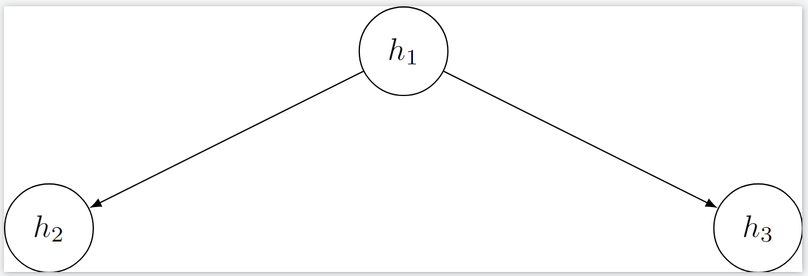
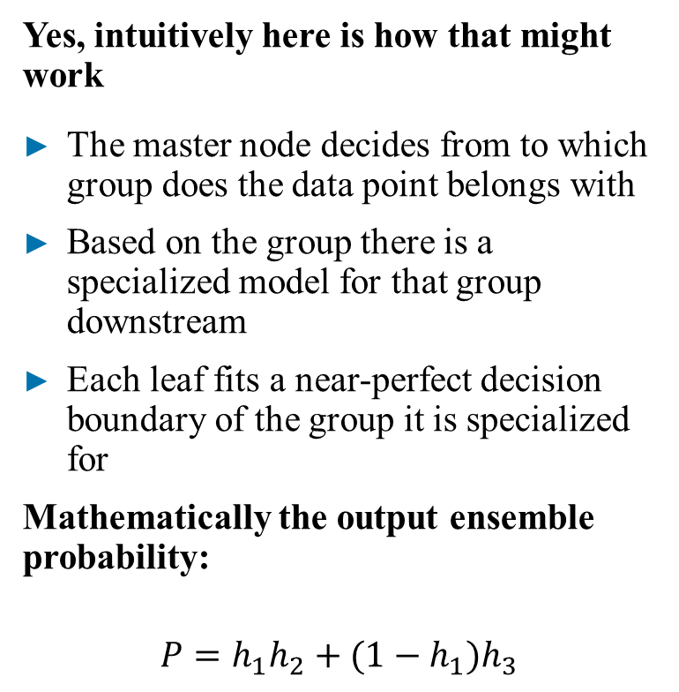
Could we do it with logistic regression model?
Yes, intuitively here is how that might work
The master node decides from to which group does the data point belongs with
Based on the group there is a specialized model for that group downstream
Each leaf fits a near-perfect decision boundary of the group it is specialized for
Mathematically the output ensemble probability:
$$P=h_{1}h_{2}+(1−h_{1})h_{3}$$
Two layered logistic ensemble

Slide 6
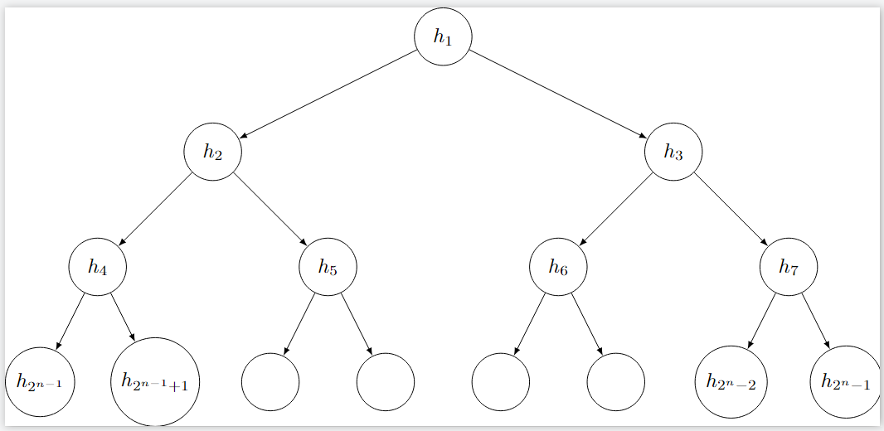
What if there are more internal groupings?
We add more layers that’s it!
Our intuition scales with layers similar to what we had for a two layered model
Then the question is
What is the ensemble probability for an n-layered model?
What is the cost function for an n-layered model? Therefore the gradients?
N-layered logistic ensemble

Slide 7
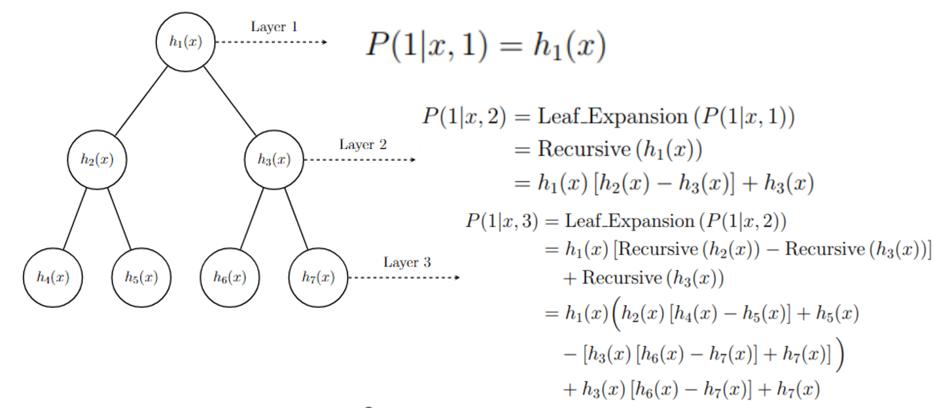
N-layered ensemble Probability
Compute efficient
Introducing recursive probability calculations in logistic ensembles
Generalization
Recursive rules applied to n-layer ensembles
Enables modeling complex decision boundaries while maintaining interpretability

Slide 8
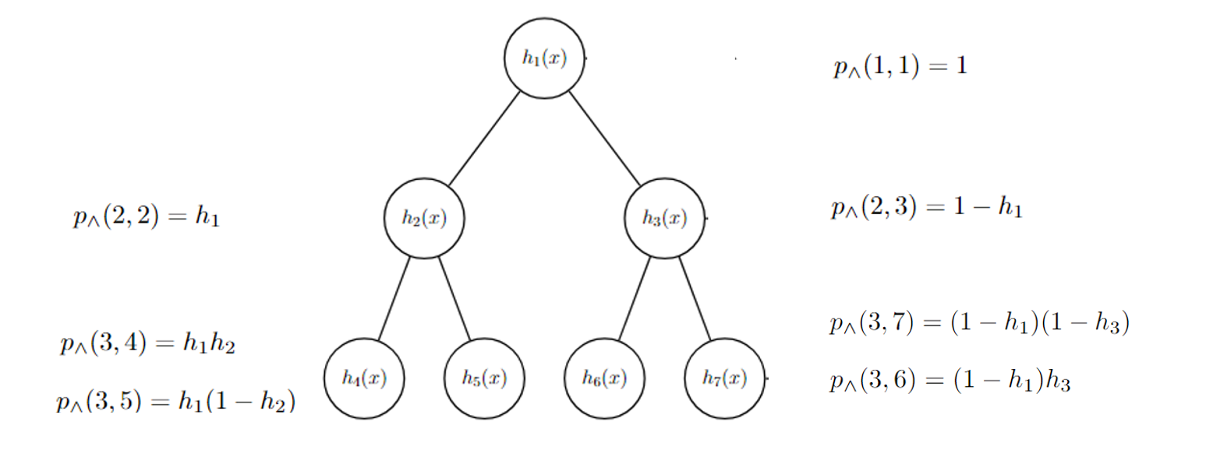
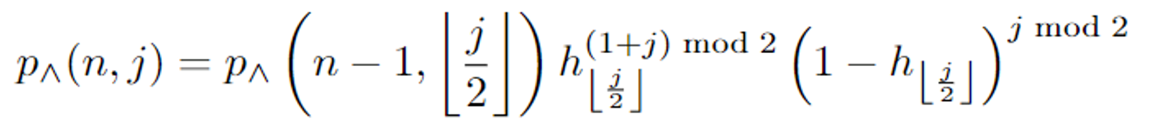
Cost, Gradient for N-layered ensemble? Gradient calculations need Path probability
The ensemble cost comes from the maximum likelihood over ensemble probabilities.
One of the simple recursive path probability calculations in logistic ensembles to help compute the gradients
Generalization
Recursive rules applied to n-layer ensembles
Enables modeling complex decision boundaries while maintaining interpretability

Slide 9
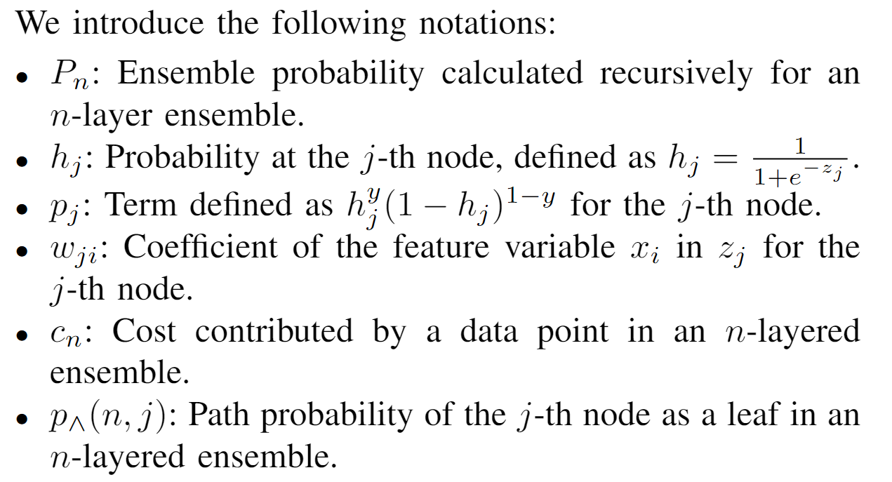
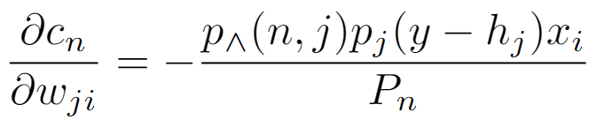
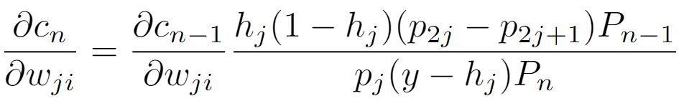
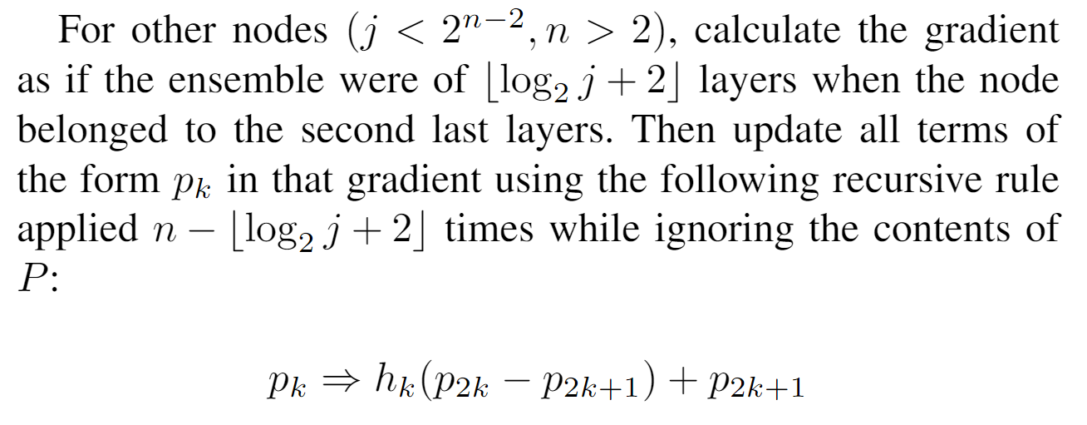
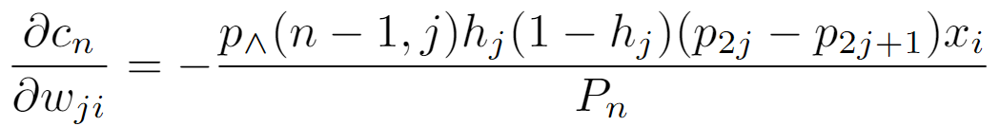


Generalized Gradient
For leaf nodes i.e. $j≥2^{n−1}$
For Parents of leafs i.e. $2^{n−2}≤j<2^{n−1}$
or

Slide 10
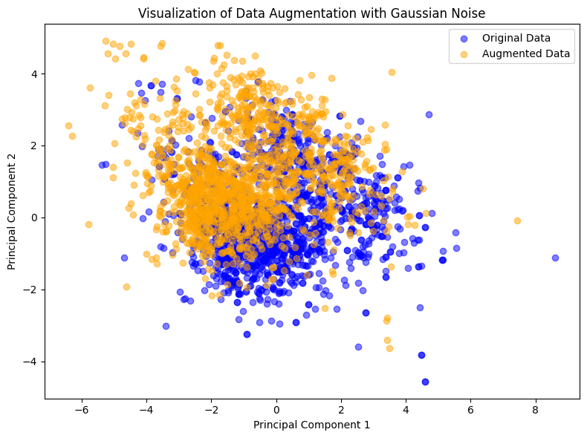
Testing Time
For testing the model we took wine dataset and modified to simulate internal group structure. Simple logistic regression model’s accuracy went down after doing that.
Wine Quality Dataset:
1,599 samples
10 features related to chemical properties of wine
Data Augmentation:
Added Gaussian noise to simulate internal clusters
Noise calculated as 10% of each feature's mean and standard deviation
Result: Dataset size doubled to 3,198 samples
Purpose:
Test the model's ability to detect inherent group structures without explicit features

Slide 11
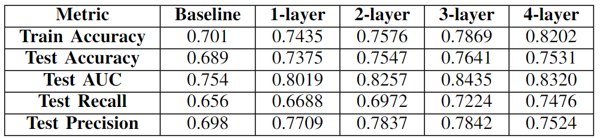
Ensemble Model Performance

Slide 12
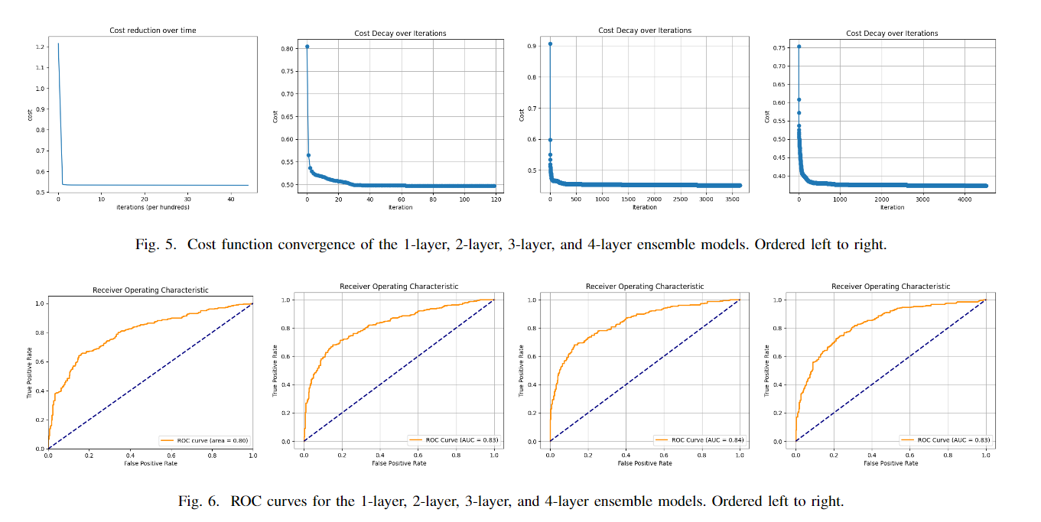

Slide 13
Github: https://github.com/ensemble-art/Dynamic-Logistic-Ensembles/tree/main
Thank You

